Slide 1
Controls follow-up
E. Hatziangeli – LHC Beam Commissioning meeting - ^{17th} March 2009

Slide 2
FESA-CMW-RBAC
Proposed changes
Actions and Dependences
FESA 2.9 and 2.10 “Inca-ification”
Mainly run FESA synchronisation to clean all ‘old’ dependencies with old RDA or RBAC libraries
CMW 3.0/RDA 2.8
bugfix related to RBAC token handling (inability of two-tier applications to properly pass tokens to the user code)
performance improvement in RBAC with array calls (token is parsed only once for the whole device group)
improvement of array calls, which now can carry the context data
parallelization improvements in array calls and configurable level of concurrency for these calls at the client side
lots of RBAC improvements (authentication by location, stronger checking policy, etc.)
small logging improvements for better diagnostics
various cleanup and technical improvements related to implementation Details
the new directory server for improved reliability and performance
There are code change and additional API
BUT old applications are guaranteed to work
JAVA application should be released with the new versions of the dependant library
FESA servers need to run FESA synchronize
C++ server need to modify Makefile to take the new versions of the libraries
NOTE for RBAC users (LHC)
Old clients will not work with new servers

Slide 3
FESA-CMW-RBAC
Calendar
Info
Did intensive internal tests
This Wednesday and Thursday dry-run with BI FESA devices
Monday 23rd March :
An information mail will be sent to all FESA, CMW and RBAC users
All new libraries will be made available
BE-CO will run both old and new directory server and RBAC server
When agreed with our users we will stop the old servers
All these changes and calendar are documented on our wiki pages
https://wikis/display/MW
https://wikis/display/LAFS/Role-Based Access Control
https://wikis/display/fesa

Slide 4
CMW Proxies
BTV Proxy
17th March configure and start proxy on one of our AS ProLiant (cs-ccr-cmw)
The instructions on how to configure applications that make subscriptions to use this proxy will be communicated to BI
We will profit from the BI dry run (CMW/RBAC tests) on the 18th of March in the CCC to make sure the proxy works correctly
Two sets of proxies
External for GPN
Internal for TN

Slide 5
LHC Central Timing
Tests requested
9th April: installation of the “LHC Telegram layout release” for as it was foreseen with OP
2rd April to test a prototype card in the LHC Central Timing to simulate LHC injection
The tests for the availability of the LHC central timing have already been done and all seems to work well

Slide 6
Logging system
Logging & SDDS
Changes/new equipment identified in Collimators, BI & BT – work ongoing
Concentrators
BLM concentrators
Set of running sums (now 9/12) expanded
Frequency of logging doubled 1Hz
Results encouraging but not conclusive – full load on MDB not present
BPM concentrator
Coming up

Slide 7
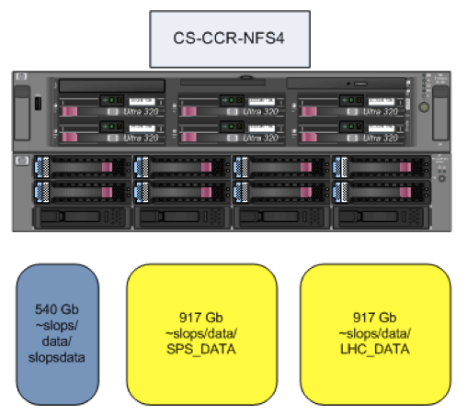
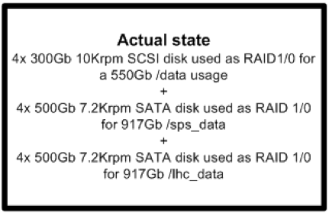
SDDS Storage
Situation Today
~900Gbytes for LHC_DATA
Old files are zipped regularly
And saved on tape via CASTOR
A few weeks data available online (depending on the size used!)

Slide 8
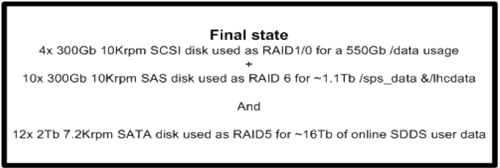
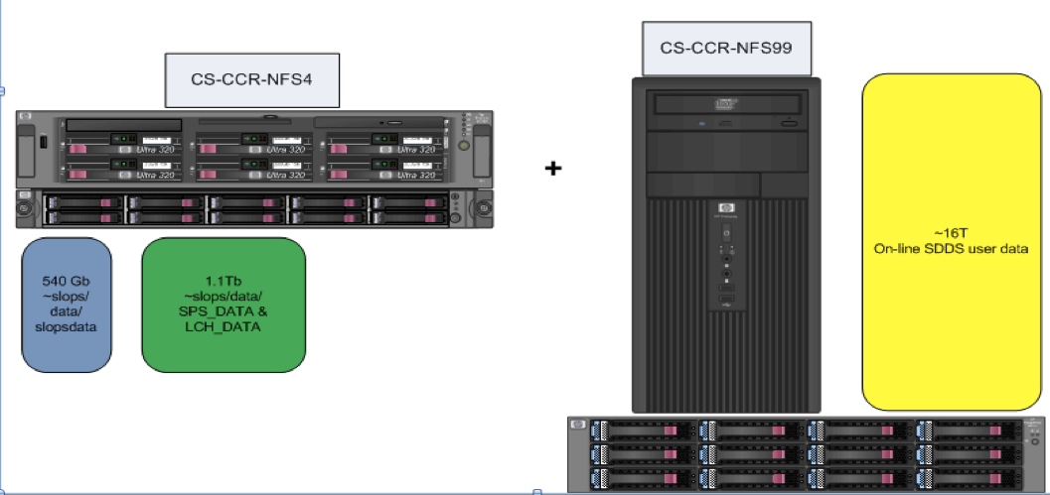
SDDS Storage
Solution
New service of ~16Tb of READ-ONLY data containing ALL SDDS data :
Copied daily from LHC_DATA
No backup (but RAID5 to secure the data)
Structured per year/month/day (TBD)
Upgrade operational LHC_DATA to 1.1 Tbytes with the same operational level :
New faster technology (SAS disks instead of SATA)
RAID, regularly zipped files and CASTOR backup
Order & HW arrival ~3 weeks
Set up & configuration ~1 week
Will need 2 stops of NFS4 (SPS and LHC data)

